Slide 1
Exception Handling
Department of Computer Science,
The University of Lahore, Pakistan

Slide 2
Exceptions
Exception: undesirable event detectable during program execution
Can add exception-handling code at point where an error can occur

Slide 3
Exception Handling Techniques
When an exception occurs, the programmer usually has three choices:
Terminate the program
Include code to recover from the exception
Log the error and continue

Slide 4
Terminate the Program
In some cases, it is best to let the program terminate when an exception occurs
For example, if the input file does not exist when the program executes
There is no point in continuing with the program
The program can output an appropriate error message and terminate

Slide 5
Fix the Error and Continue
In some cases, you will want to handle the exception and let the program continue
For example, if a user inputs a letter in place of a number
The input stream will enter the fail state
You can include the necessary code to keep prompting the user to input a number until the entry is valid

Slide 6
Log the Error and Continue
For example, if your program is designed to run a nuclear reactor or continuously monitor a satellite
It cannot be terminated if an exception occurs
When an exception occurs
The program should write the exception into a file and continue to run

Slide 7
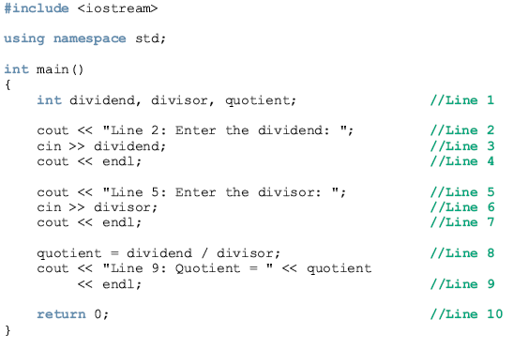

Slide 8
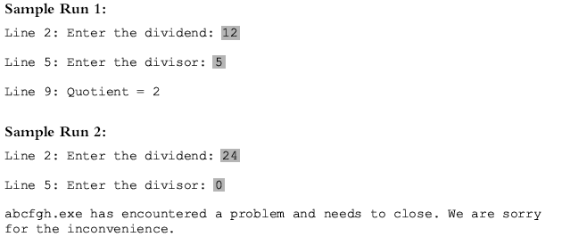

Slide 9
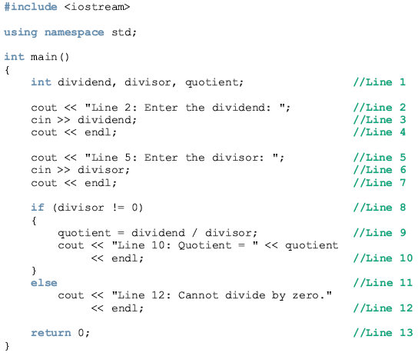

Slide 10
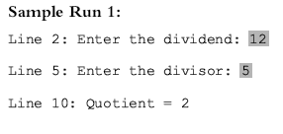
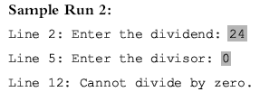

Slide 11
C++ Mechanisms of Exception Handling
The try/catch block handles exceptions
Exception must be thrown in a try block and caught by a catch block
C++ provides support to handle exceptions via a hierarchy of classes

Slide 12
try/catch Block
Statements that may generate an exception are placed in a try block
The try block also contains statements that should not be executed if an exception occurs
The try block is followed by one or more catch blocks

Slide 13
try/catch Block (continued)
The catch block:
Specifies the type of exception it can catch
Contains an exception handler
If the heading of a catch block contains ... (ellipses) in place of parameters
Catch block can catch exceptions of all types

Slide 14
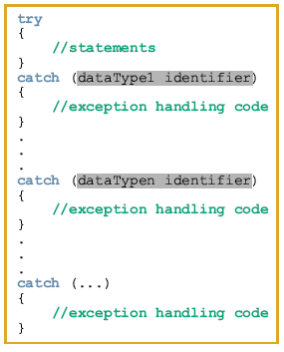
General syntax of the try/catch block

Slide 15
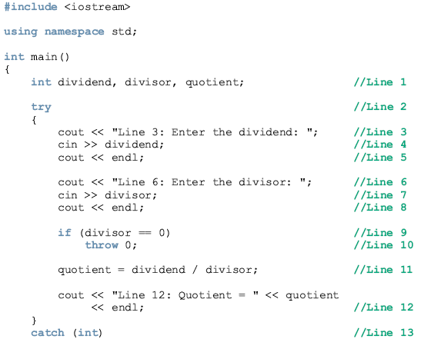
Using try/catch Blocks in a Program

Slide 16
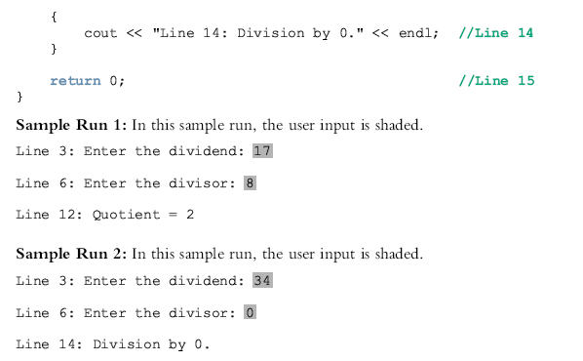

Slide 17
try/catch Block (continued)
If no exception is thrown in a try block
All catch blocks for that try block are ignored Execution resumes after the last catch block
If an exception is thrown in a try block
Remaining statements in that try block are ignored

Slide 18
try/catch Block (continued)
The program searches catch blocks in order, looking for an appropriate exception handler
If the type of thrown exception matches the parameter type in one of the catch blocks:
Code of that catch block executes
Remaining catch blocks are ignored

Slide 19
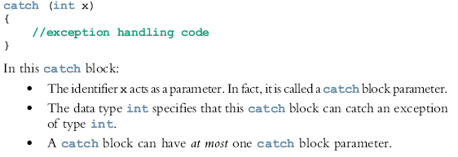
try/catch Block (continued)

Slide 20

Throwing an Exception
For try/catch to work, the exception must be thrown in the try block
General syntax to throw an exception is:
where expression is a constant value, variable, or object

Slide 21
Throwing an Exception (continued)
The object being thrown can be:
Specific object
Anonymous object
In C++
An exception is a value
throw is a reserved word

Slide 22
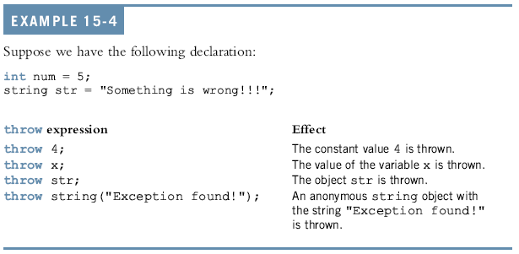
Throwing an Exception (continued)

Slide 23
Order of catch Blocks
Catch block can catch
All exceptions of a specific type
All types of exceptions
A catch block with an ellipses (three dots) catches any type of exception
In a sequence of try/catch blocks, if the catch block with an ellipses is needed
It should be the last catch block of that sequence

Slide 24
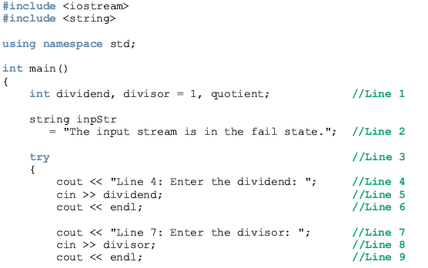
Example 15-7

Slide 25
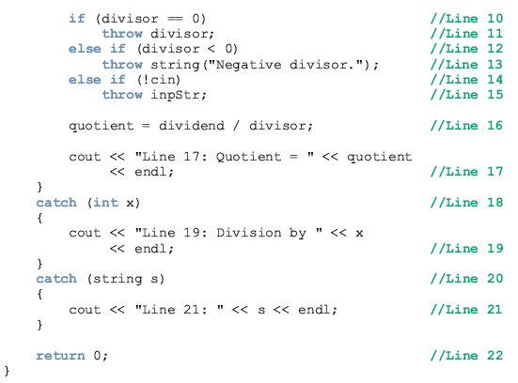

Slide 26
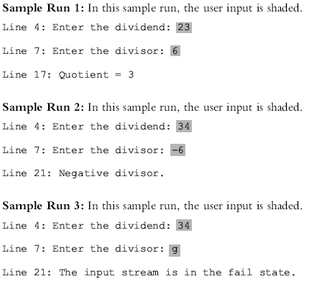

Slide 27
Using C++ Exception Classes
C++ provides support to handle exceptions via hierarchy of classes
The class exception is:
The base class of the exception classes provided by C++

Slide 28
Using C++ Exception Classes (continued)
Two classes derived from exception:
logic_error
runtime_error
The class invalid_argument deals with illegal arguments used in a function call

Slide 29
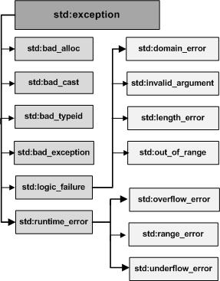
Using C++ Exception Classes (continued)

Slide 30
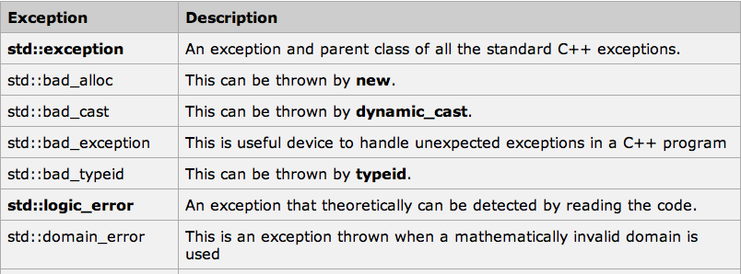
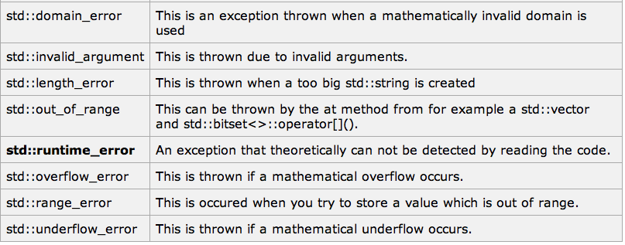
Using C++ Exception Classes (continued)

Slide 31
Using C++ Exception Classes (continued)
The class out_of_range deals with the string subscript out_of_range error
The class length_error handles the error if
A length greater than the maximum allowed for a string object is used

Slide 32
Using C++ Exception Classes (continued)
If the operator new cannot allocate memory space
It throws a bad_alloc exception
The class runtime_error deals with errors that occur only during program execution
Classes overflow_error and underflow_error
Deal with arithmetic overflow and under-flow exceptions
Derived from the class runtime_error

Slide 33
Using C++ Exception Classes (continued)
The function what returns the string containing exception object thrown by C++’s built-in exception classes

Slide 34
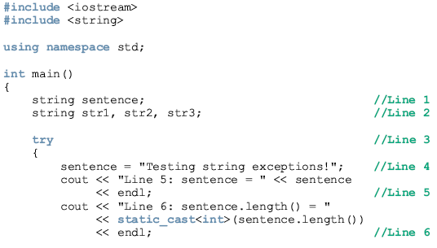
exceptions out_of_range and length_error

Slide 35
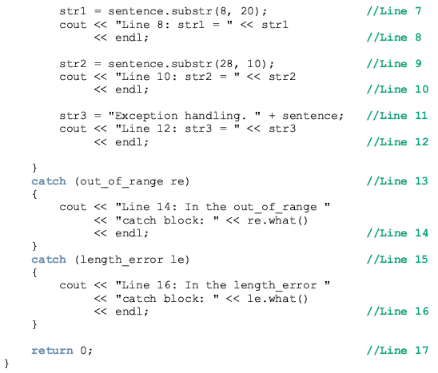

Slide 36
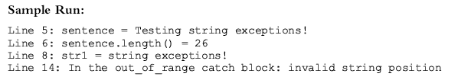

Slide 37
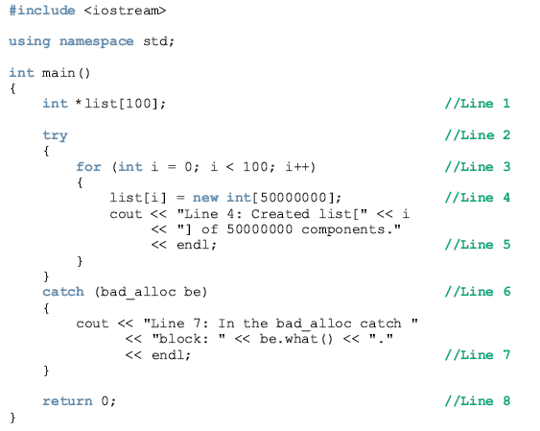
exception bad_alloc

Slide 38
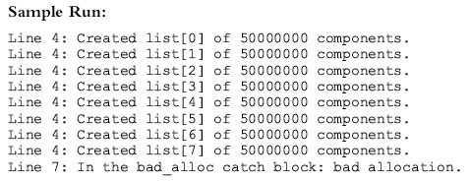

Slide 39
Creating Your Own Exception Classes
Programmers can create exception classes to handle exceptions not covered by C++’s exception classes and their own exceptions
C++ uses the same mechanism to process the exceptions you define as for built-in exceptions
You must throw your own exceptions using the throw statement
Any class can be an exception class

Slide 40
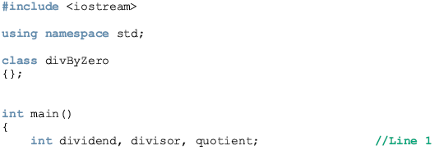
Creating Your Own Exception Classes

Slide 41
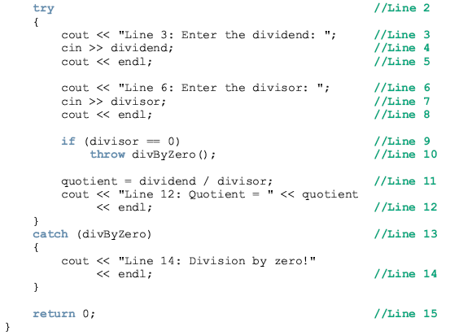
Creating Your Own Exception Classes

Slide 42
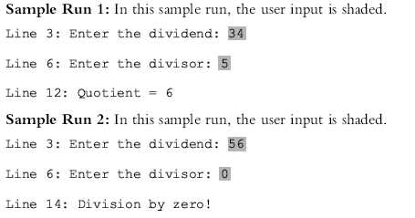
Creating Your Own Exception Classes

Slide 43
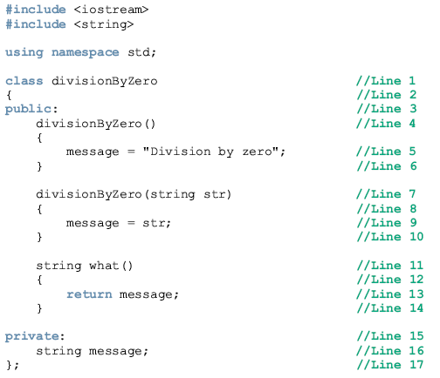
Creating Your Own Exception Classes

Slide 44
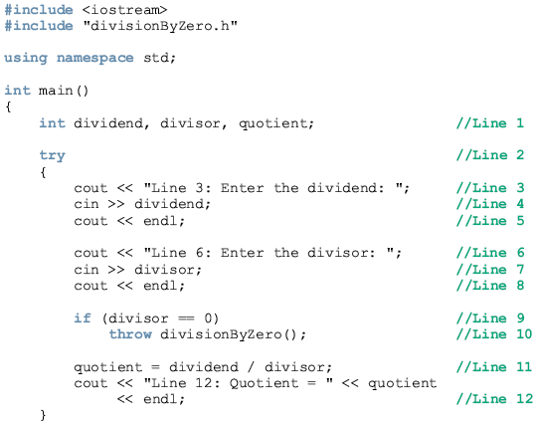
Creating Your Own Exception Classes

Slide 45
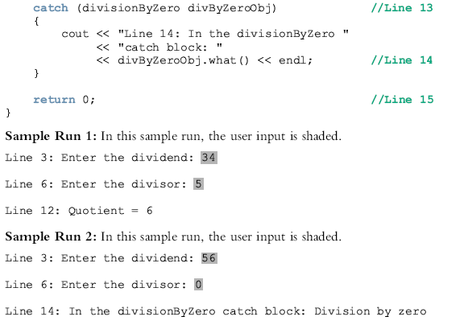
Creating Your Own Exception Classes

Slide 46
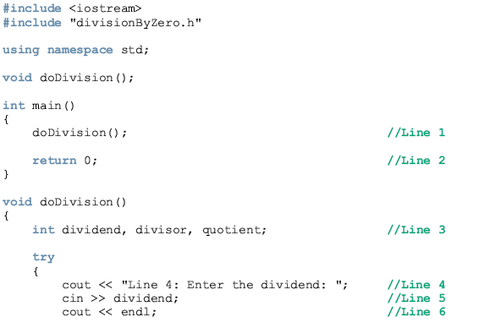
Creating Your Own Exception Classes

Slide 47
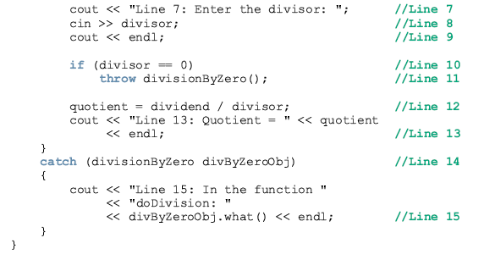
Creating Your Own Exception Classes

Slide 48
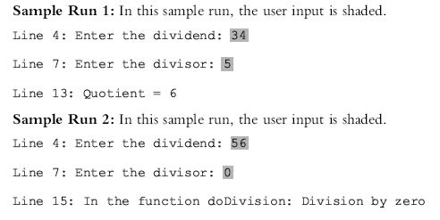
Creating Your Own Exception Classes

Slide 49
Rethrowing and Throwing an Exception
When an exception occurs in a try block
Control immediately passes to one of the catch blocks
A catch block either
Handles the exception or partially processes the exception and then rethrows the same exception OR
Rethrows another exception for the calling environment to handle

Slide 50


Rethrowing and Throwing an Exception (continued)
The general syntax to rethrow an exception caught by a catch block is:
(in this case, the same exception is rethrown) or:
where expression is a constant value, variable, or object

Slide 51
Summary
Exception: an undesirable event detectable during program execution
assert checks whether an expression meets a specified condition and terminates if not met
try/catch block handles exceptions
Statements that may generate an exception are placed in a try block
Catch block specifies the type of exception it can catch and contains an exception handler

Slide 52
Summary (continued)
If no exceptions are thrown in a try block, all catch blocks for that try block are ignored and execution resumes after the last catch block
Data type of catch block parameter specifies type of exception that catch block can catch
Catch block can have at most one parameter
exception is base class for exception classes
what returns string containing the exception object thrown by built-in exception classes

Slide 53
Summary (continued)
Class exception is in the header file exception
runtime_error handles runtime errors
C++ enables programmers to create their own exception classes

